Slide 1

Erlang Runtime System
(Deep Dive)

Slide 2




RUNTIME SYSTEM (Deep Dive)
presented by Bryan Hunter Firefly Logic
Twitter #devLink #erlang
@bryan_hunter
@fireflylogic

Slide 3

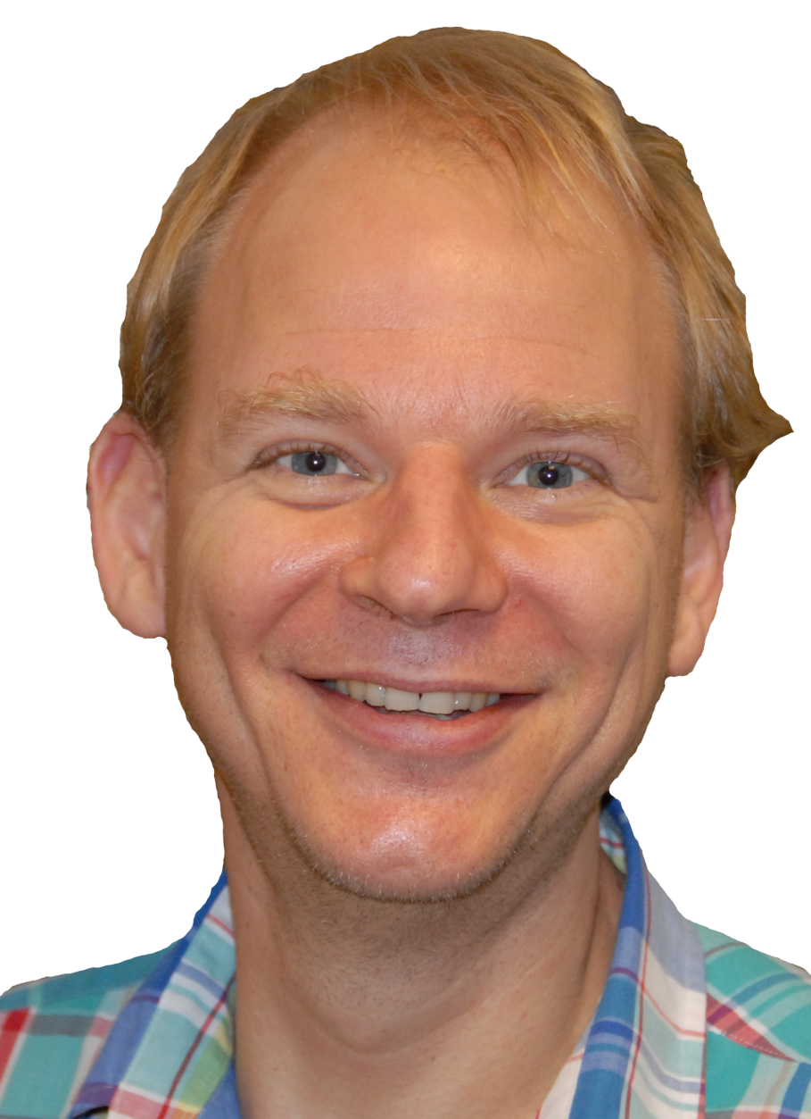
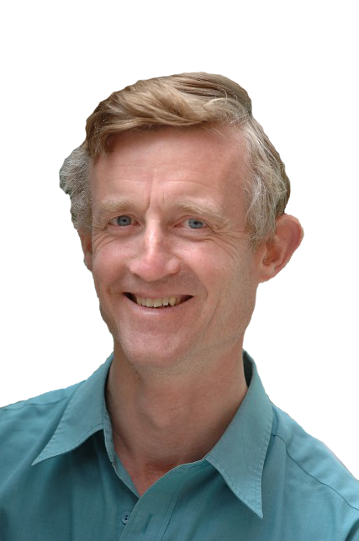
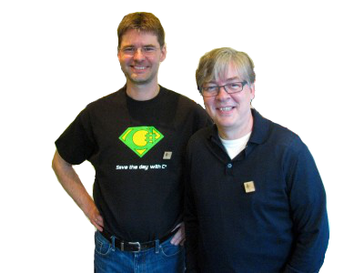
Good question, Bryan!
What should
Ooo, ooo! I know!
The Erlang Runtime System!
ing?
be
Erlang!
Erlang!
Erlang!

Slide 4
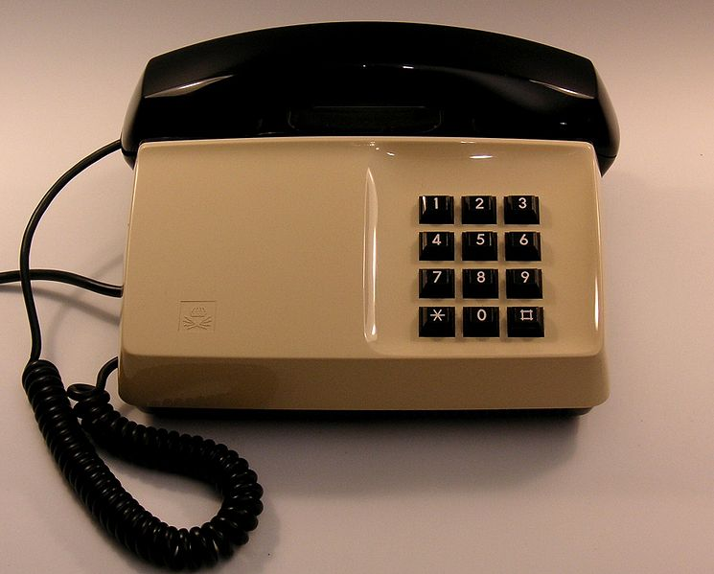
Why?

Slide 5
“Erlang is a programming language used to build
massively scalable
soft real-time systems
with requirements on high availability”
-from www.erlang.org

Slide 6

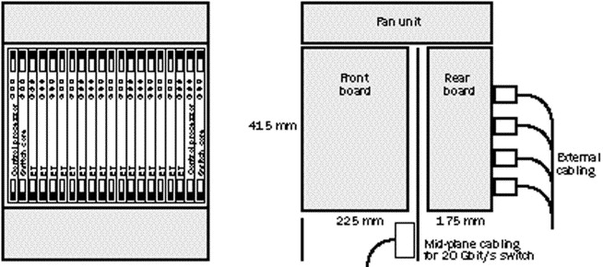
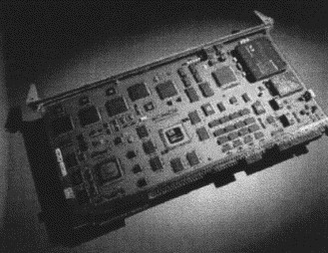
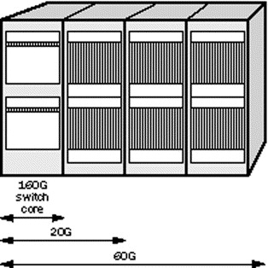
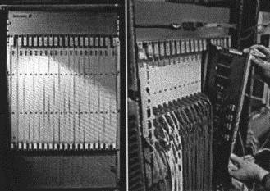

Slide 7
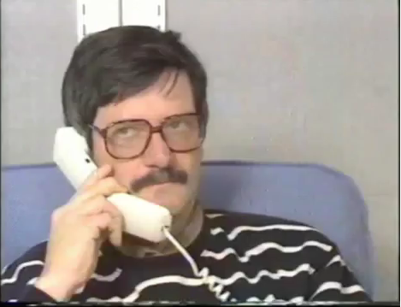

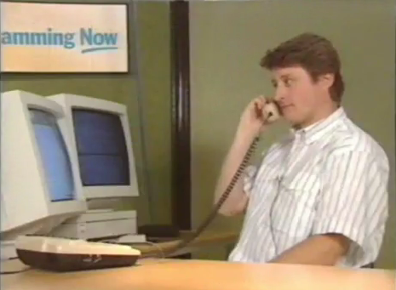
Joe
Mike
Robert
THE MOVIE

Slide 8
Erlang.
What exactly is Erlang?
Why Erlang?
How do you do it?
Erlang (the language)
+ OTP (libraries, pattern implementations)
+ ERTS (Erlang Runtime System)

Slide 9
Erlang (the Language)
Functional
immutability, higher-order functions, referential transparency, separation of behavior and data, recursion,
Concurrency- oriented
Different model of the world
Prolog roots
Pattern matching

Slide 10
Erlang OTP
Libraries and design principles
Middle-ware
A distributed database
Applications to interface other languages
Debugging
Release handling tools.

Slide 11
Erlang Runtime System
A special purpose operating system built for
Concurrency (processes)
Distribution (nodes)
Fault tolerance

Slide 12
Erlang?
What exactly is Erlang?
Why Erlang?
How do you do it?
Erlang is open, proven and cross-platform. It simplifies writing reliable, concurrent, distributed systems. Its pattern matching is FTW.

Slide 13
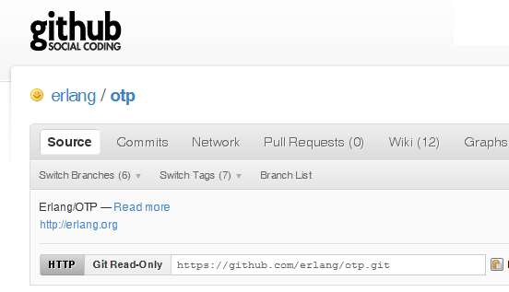

Why -> Erlang is open

Slide 14
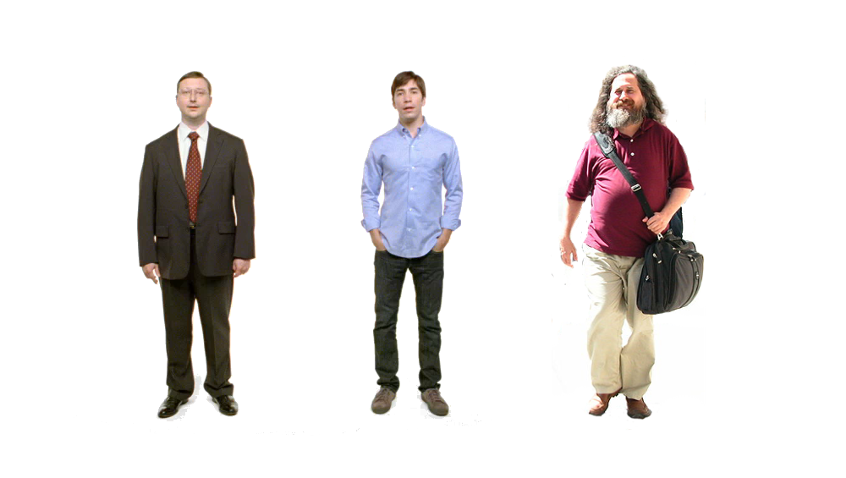

Erlang
Erlang
Erlang
Erlang
ARM
Why -> Erlang is cross-platform

Slide 15













Why -> Erlang is proven

Slide 16
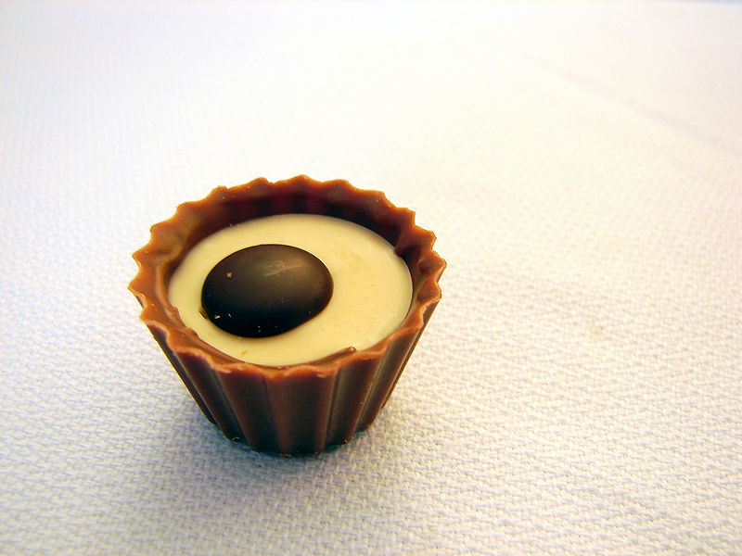
What are the sweet spots?

Slide 17
Two thing to remember about
Concurrency
1) Shared memory concurrency is hard
2) Message passing concurrency is easy

Slide 18
“The performance
of a concurrent language
is predicated by three things:
the context switching time,
The message passing time,
and the time to create a process.”
–Mike Williams

Slide 19
Erlang Processes
are the unit of concurrency.
You structure your programs around these units of concurrency.

Slide 20
Erlang Processes
Interestingly in OO, the “best” form
of cohesion is functional cohesion
“functional cohesion: is when parts
of a module are grouped because
they all contribute to a
single well-defined task.” –wikipedia (cohesion)

Slide 21
Processes are Lightweight
grow and shrink dynamically
small memory footprint
fast to create and terminate
scheduling overhead is low

Slide 22
One .NET 4.0 Thread (allocates one megabyte)
**********
**********
**********
**********
**********
**********
**********
**********
**********
**********
**********
**********
**********
**********
**********
**********
**********
**********
**********
**********
**********
**********
**********
**********
**********
**********
**********
**********
**********
**********
**********
**********
**********
**********
**********
**********
**********
**********
**********
**********
**********
**********
**********
**********
**********
**********
**********
**********
**********
**********
Heap
Mailbox
Stack
**********
**********
**********
**********
**********
**********
**********
**********
**********
**********
**********
**********
**********
**********
**********
**********
**********
**********
**********
**********
**********
**********
**********
**********
**********
**********
**********
**********
**********
**********
**********
**********
**********
**********
**********
**********
**********
**********
**********
**********
**********
**********
**********
**********
**********
**********
**********
**********
**********
**********
Garbage Collector
Links and Monitors
One Erlang Process (allocates one kilobyte)
*

Slide 23
*
*
*
Reductions
- Do 2,000 operations
reduction1 reduction3 .
Reduction2000
- Move to the next guy - Repeat
CPU Core

Slide 24
***** *****
***** *****
***** *****
***** *****
Core
Core
Core
Core

Slide 25


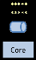
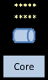
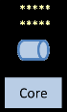
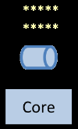
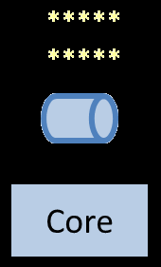
Distribution: built-in from the start

Slide 26
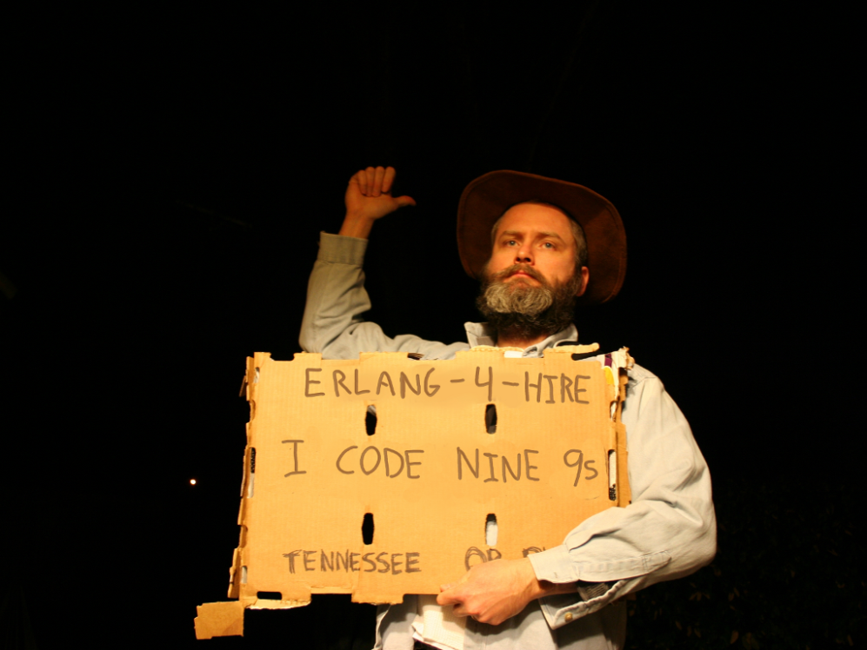
Nines | Uptime | Annual Downtime
9 | 99.9999999% | 30 milliseconds
8 | 99.9999990% | 300 milliseconds
7 | 99.9999900% | 3 seconds
6 | 99.9999000% | 32 seconds
5 | 99.9990000% | 5 minutes
4 | 99.9900000% | 53 minutes
3 | 99.9000000% | 8 hours, 46 minutes
2 | 99.0000000% | 3 days, 15 hours, 36 minutes
Safe
Supervisor
Worker
Worker
Links and monitors
No masters
Hot code loading
simple distribution, safe concurrency

Slide 27
[insert awe-inspiring demo here]

Slide 28

What should
ing?
be
Psst…don’t forget to show them my PDF

Slide 29
Erlang Runtime System
made up of the following parts:
the Erlang virtual machine
the kernel
the standard library

Slide 30
The virtual machine
a consistent operating system interface on all platforms
memory allocation and real-time garbage collection
light-weight concurrency and support for thousands of simultaneous tasks
transparent co-operation between all computers in the system
location and encapsulation of run-time errors
supervision of run-time code as it loads, when it is replaced, and while it is linked.

Slide 31
The kernel
The first application to be started.
It provides low-level services needed
to start the ERTS,
to participate in a distributed system,
to handle errors,
and to perform IO operations.

Slide 32
Distribution and Nodes
A node is an instance of the ERTS
Name, a cookie and a net_adm:ping connects nodes into a cluster.
Connections are transitive by default

Slide 33
Useful modules
global: A global name registration facility.
global_group: Grouping nodes to global name registration groups.
net_adm: Various Erlang net administration routines.
net_kernel: Erlang networking kernel.

Slide 34
Erlang Port Mapper Daemon
Started at every host where an Erlang node is started.
Responsible for mapping the symbolic node names to machine addresses.

Slide 35
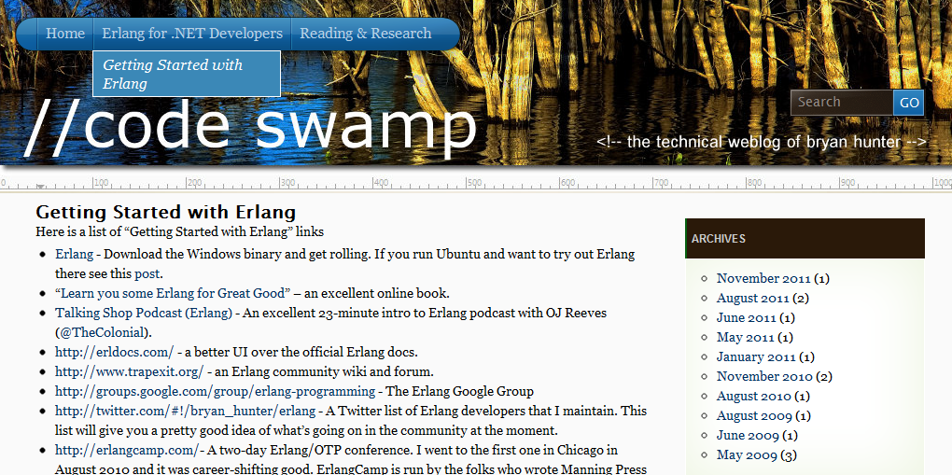
“Getting started” links, script to build Erlang from source on Ubuntu, ongoing screencasts of the Erlang tool-chain,
Info on the book-in-progress “Erlang for .NET Developers”
How -> visit my blog at http://www.codeswamp.com

Slide 36
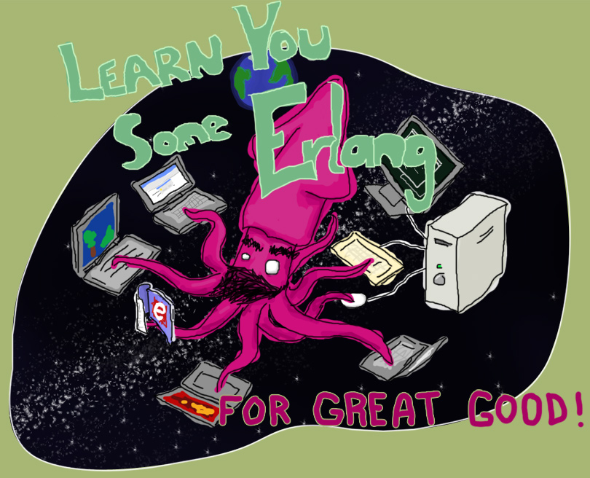
“Learn You Some Erlang for Great Good!” http://learnyousomeerlang.com/
How -> read this excellent and free online book

Slide 37



How -> read some books

Slide 38

Search “pragmatic kevin smith”
How -> code alongside Kevin Smith for eight screencasts

Slide 39
NashFP Nashville Functional Programmers
http://nashfp.github.com
How -> join your local FP group

Slide 40
Bryan Hunter
Twitter: @bryan_hunter
Email: bryan.hunter@fireflylogic.com
Blog: codeswamp.com
Firefly Logic, Inc.
1000 Main Street, Suite 201 Nashville, TN 37206
http://fireflylogic.com
How -> keep in touch

